Slide 1
C# Huffman Encoding
Kiril Shiyan 273222008

Slide 2
Introduction
This project implements the Huffman Encoding Algorithm, a widely-used technique for lossless data compression. It utilizes the principles of frequency-based binary tree construction to assign variable-length codes to characters. Frequently occurring characters are assigned shorter codes, while less frequent characters are assigned longer codes, ensuring an efficient encoding scheme.

Slide 3
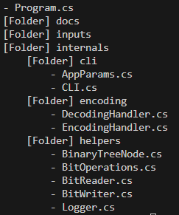
Project Structure

Slide 4
EncodingHandler
(List<bool>? bits, ErrorCodes error) HuffmanEncode(FileStream source) – Encode text file.
(List<bool>? bits, ErrorCodes error) HuffmanEncode(string source) – Encode string.
List<bool> MergeTableAndBinData(Dictionary<char, List<bool>> table, List<bool> binData) – Merges huffman table end encoded data.
List<bool> EncodeString(string source, Dictionary<char, List<bool>> table) – Takes string and huffman table and encodes stirng.
(Dictionary<char, List<bool>>? table, ErrorCodes errorCode) GetHuffmanTable(string source) – Counts occurrences of characters in string, builds binary table and generates huffman table, .

Slide 5
DecodingHandler
(string str, ErrorCodes error) HuffmanDecode(List<bool> bits) – Reads binary data, builds huffman table, and decodes binary stream to string.

Slide 6
CLI
ErrorCodes ProcessCommandArguments(string[] args) – Process command arguments and sets up AppParams.
void PrintError(ErrorCodes errorCodes) – Prints error in user-friendly format.
void PrintHelp() – Prints help to user.
ErrorCodes ProcessOutputLocation() – Sets up output location in AppParams

Slide 7
Utils
BinaryTreeNode.cs – Implementation of binary tree.
BitOperations.cs – Utils for bit manipulations.
BitReader.cs – Reads binary data from file.
BitWriter.cs –Writes binary data to file.
Logger.cs – Logger utils.

